Slide 1

SRM INSTITUTE OF SCIENCE AND TECHNOLOGY Ramapuram , Chennai – 600 089 DEPARTMENT OF COMPUTER SCIENCE AND ENGINEERING
18CSP103L-SEMINAR - 1
Title of the Project:Pixel Whispers Unveiling the Secrets of Image Steganography
BATCH NUMBER :12
Team Members | Supervisor
BHASKAR RAJA M (RA2111030020006) SREEHARI K (RA2111030020010) LV MANIKANTA M (RA2111030020033) | Dr. S.RUBIN BOSE., M.E., M.B.A., Ph.D. Ms. P.VIDYASRI., M.E. (Assistant Professors, Department of Computer Science and Engineering)

Slide 2
ABSTRACT
Image steganography is principally the art of embedding secret information in images. This fashion is largely sought after for private communication and data encryption because the ubiquity of images and its capability to contain large quantities of information Steganographic algorithms make it easy to bed retired dispatches in images unnoticeable to the mortal eye.
Image steganography is an important tool for covert communication and data integration. A comprehensive understanding of colorful steganographic ways, their operations, features and selection criteria enables druggies to make informed choices to cover their sensitive information.

Slide 3
Scope and Motivation
The scope of "Pixel Whispers: Unveiling the Secrets of Image Steganography" involves in-depth research on existing steganography methods, aiming to analyze their strengths and weaknesses. This investigation extends to developing improved techniques for securely embedding and extracting data within digital images while ensuring image quality. The project also focuses on creating robust detection mechanisms to identify hidden information, considering ethical implications and applications in cybersecurity, forensics, and privacy protection.

Slide 4
Introduction
Steganography is distinct from cryptography as it aims to conceal messages rather than encrypt them. While cryptography secures data, steganography hides the message's existence, avoiding attention. Watermarking and fingerprinting are related techniques that protect intellectual property through permanent signals and distinct marks. Evaluating steganographic systems involves imperceptibility, capacity, and robustness. Digital image formats are commonly used due to their redundancy.

Slide 5
Objective
The ideal of" Pixel tales Unveiling the Secrets of Image Steganography" is to claw into the realm of image steganography, aiming to uncover, dissect, and potentially advance ways used in concealing information within digital images. The design seeks to explore colorful methodologies, algorithms, and tools employed in this field, aiming to enhance understanding and develop new approaches for embedding and rooting retired data.

Slide 6
Problem Statement
"Pixel Whispers: Unveiling the Secrets of Image Steganography" confronts a multifaceted landscape of challenges surrounding the covert embedding of information within digital images. Image steganography, while holding potential for secure 2 communication and data hiding, also presents significant concerns regarding its potential misuse. The project aims to comprehensively investigate this field, focusing on multiple aspects such as the intricacies of concealing information within the visual data of images, understanding various embedding techniques, the vulnerabilities associated with these methods, and exploring the efficacy of detection and extraction mechanisms.

Slide 7
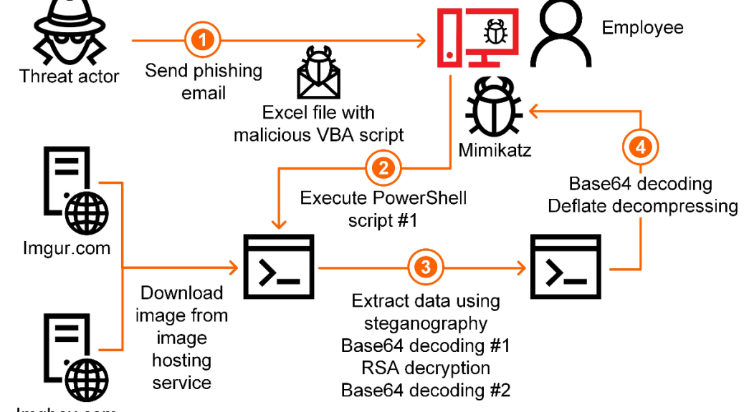
Architecture Diagram

Slide 8
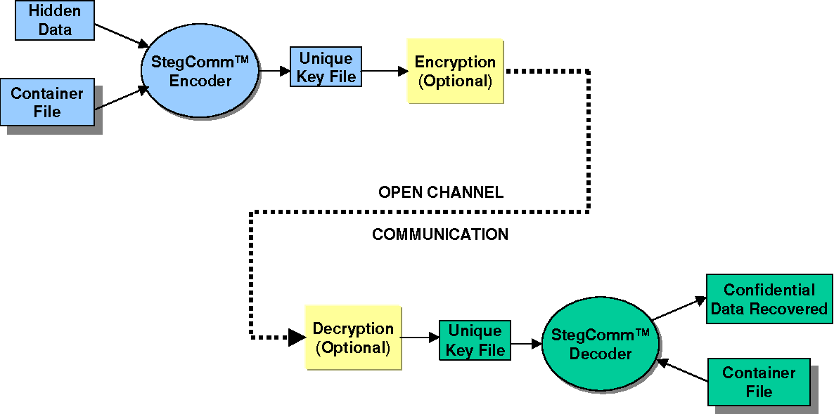
Data Flow Diagram

Slide 9
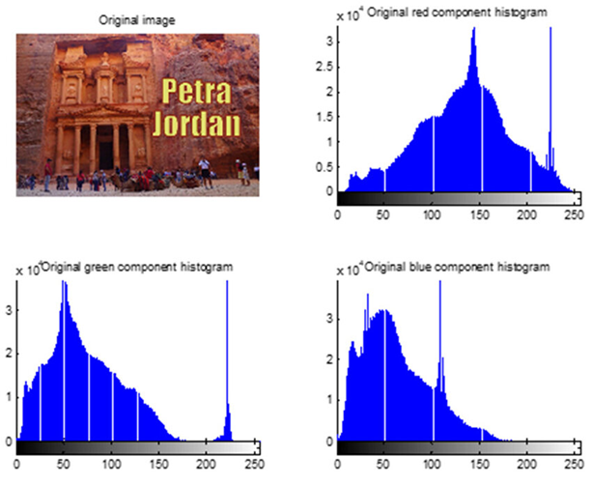
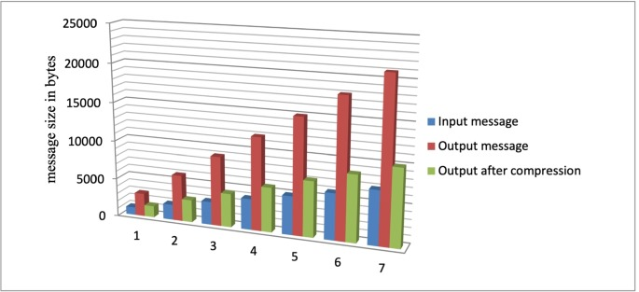

Slide 10
Proposed Work
By leveraging methods like altering LSBs and frequency domain transformations, sensitive data can be discreetly embedded in digital images. To overcome size, color depth, and imperceptibility constraints, advanced encryption techniques are integrated before embedding, ensuring the hidden data's robust security. The system's performance evaluation remains focused on imperceptibility, capacity, and robustness.

Slide 11
Software & Hardware Requirements
iOS : iOS 15 or Above
Android : Android OS 10 or Above
Mac : OS X 10.11 or Above
Windows : Windows 10 or Above

Slide 12
Implementation
Implementing image steganography involves selecting a cover image and encoding data into it using a steganographic algorithm. The least significant bits are typically modified for minimal visual impact, and encryption can be added for security. The resulting stego image conceals the data, and extraction involves applying the reverse process to retrieve the information without visibly altering the image.

Slide 13

Results and Discussion

Slide 14
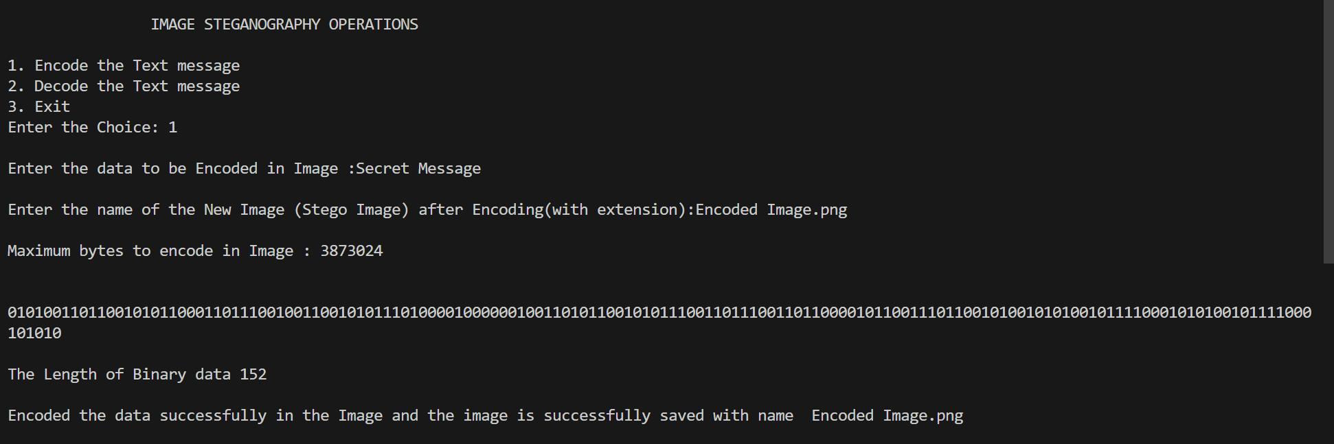
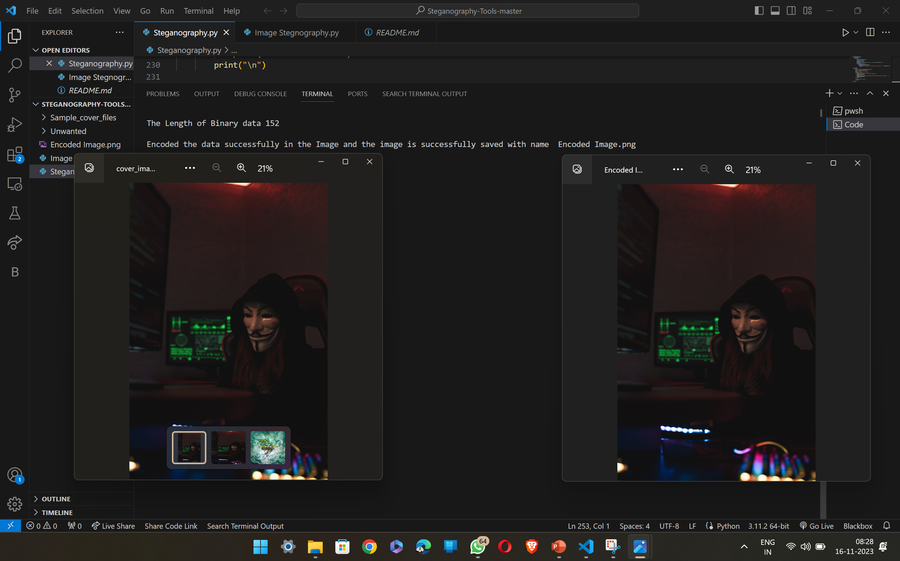
BEFORE
AFTER

Slide 15
Conclusion
We conclude that this project marks a significant stride in concealing data within digital images. Through refined algorithms and encryption integration, it achieved a delicate balance between data security and visual quality. Detection methods proved robust, ensuring effective identification of concealed information. The user-friendly terminal tool showcased practical usability.

Slide 16
Future Work
Data Concealment within Images:
1. Pixel Manipulation Techniques: Embedding hidden information within digital images using methods such as altering the least significant bits (LSBs) or utilizing frequency domain transformations like Discrete Cosine Transform (DCT).
2. Vulnerabilities and Limitations: Considering factors such as image size, color depth, and imperceptibility, which could impact the effectiveness of concealment and potentially make the hidden information vulnerable to detection.

Slide 17
References
[1] Ashwak ALabaichi, Maisa'a Abid Ali K. Al-Dabbas, Adnan Salih , "Image steganography using least significant bit and secret map techniques," International Journal of Electrical and Computer Engineering (IJECE) Vol. 10, No. 1, February 2020, pp. 935~946, doi: Oct 11, 2019.
[2] Nandhini Subramanian, Omar Elharouss , Somaya AL-Maadeed, Ahmed Bouridane, "Image Steganography: A Review of the Recent Advances," Department of Computer Science and Engineering, Qatar University, Doha, Qatar, Department of Computer and Information Sciences, Northumbria University, Newcastle upon Tyne NE1 8ST, U.K.,
[3] Jiaohua Qin, Yuanjing Luo, Xuyu Xiang, Yun Tan, And Huajun Huang, "Coverless Image Steganography: A Survey," College of Computer Science and Information Technology, Central South University of Forestry and Technology, Changsha 410004, China, pp. 1-4, doi: 19 Aug, 2019.
[4] Elsevier B.V . Inverted LSB image steganography using adaptive pattern to improve imperceptibility. 1319-1578/! 2021 The Authors. Published by Elsevier B.V. on behalf of King Saud University.
[5] Jian Zhang.Robust Invertible Image Steganography.Published by IEEE Xplore.Peking University Shenzhen Graduate School, Peng Cheng Laboratory, Shenzhen, China.

Slide 18
[6] Medi Hussain, Ainuddin Wahid Abdul Wahib, Yamani Idna Bin Idris, Anthony T.S. Ho, Ki-Hyun Jung, “Signal Processing: Image Communication,”50 Gamasil-gil, Hayang- 24 eup, Gyeongsan-si, Gyeongbuk 38428, Republic of Korea. doi: 28 Mar, 2018.
[7] Bin Li, Junhui He, Jiwu Huang, Yun Qing Shi, “ A Survey on Image Steganography and Steganalysis,”Department of Electrical and Computer Engineering, New Jersey Institute of Technology, Newark, NJ 07102, USA. doi: October 2010 .
[8] Alaa A. Jabbar Altay, Shahrin Sahib, “ An Introduction to Image Steganography Techniques,” Faculty of Information & Communication Technology, Universiti Teknikal Malaysia Melaka, 76100 Melaka, Malaysia, Almustansryah Univ, Bghdad, Iraq. doi: 28 May 2014.
[9] Nagham Hamid, Abid Yahya, R. Badlishah Ahmad, Osamah M. Al-Qershi, “ Image Steganography Techniques:An Overview,” University Malaysia Perlis (UniMAP), School of Communication and Computer Engineering , Perlis, Malaysia, doi: 2012.
[10] Abbas Cheddad , Joan Condell, Kevin Curran, Paul Mc Kevitt, “ Signal Processing”School of Computing and Intelligent Systems, Faculty of Computing and Engineering, University of Ulster at Magee, Londonderry, BT48 7JL, Northern Ireland, UK, doi: 17 August 2009.

Slide 19
[11] Masoud Nosrati, Ronak Karimi, Mehdi Hariri, “ An introduction to steganography methods,” published by World Applied Program, Kermanshah University of Medical Science, Iran. Vol (1), No (3), pp. 191-195, doi: August 2011 .
[12] Atallah M. Al-Shatnawi, “ A New Method in Image Steganography with Improved Image Quality,” Published by Applied Mathematical Sciences, Department of Information Systems, Al-albayt University , Mafraq, Jordan, Vol. 6, 2012, no. 79, pp.3907 - 3915, doi: March,2012. 25
[13] R.Poornima and R.J.Iswarya, “ An Overview of Digital Image Steganography,” published by International Journal of Computer Science & Engineering Survey (IJCSES),M.Tech., Department Of Advanced Computing, Sastra University,India,Vol.4 No.1, doi: February 2013.
[14] Shika Sharda, Sumit Bhudiraja, “Image Steganography: A Review,” published by International Journal of Emerging Technology and Advanced Engineering ISSN 2250- 2459, ISO 9001:2008 Certified Journal, Volume 3, Issue 1,Assistant Professor, Department of Electronics and Communication Engineering, UIET, Panjab University, Chandigarh, doi: Jan, 2008 .
[15] Anita Pradhan, Aditya Kumar Sahu, Gandharba Swain, K. Raja Sekhar, “Performance Evaluation Parameters of Image Steganography Techniques,” International Conference on Research Advances in Integrated Navigation Systems (RAINS - 2016), R. L. Jalappa Institute of Technology, Doddaballapur, Bangalore, India, doi: April 06-07, 2016.

